Slide 1

IOT : Its Applications and Research Challenges
UNIVERSITY OF OTTAWA
ELG5134F: Computer Communications and Networks
Presented By: Group 25
MOHD FAISAL (300130850)
SHAHZEB FARRUK (300130852)
ZAREEF AL ISLAM (300141706)
MANU SHARMA (300125688)
DATE: 20th November, 2019

Slide 2
OVERVIEW
1. THE AMAZING POTENTIAL OF IOT
Introduction
Components of an IOT system
Human Vs. Machine
Connect, Communicate and Share
2. FUTURE VALUE OF IOT
3. APPLICATIONS OF IOT
Waste Management and Weather Monitoring
Home Automation
4. RESEARCH CHALLENGES OF IOT
Design for energy efficient IIOT sensor nodes
Low cost sensors will help IOT to be realized
Power Consumption of the radio signals used
Building Security into IOT Devices
Meeting the PCB design Challenges
5. CONCLUSION

Slide 3
1.1 INTRODUCTION
The Internet of Things (IoT) is the network of physical objects embedded with electronics, software, sensors, and network connectivity—that enables these objects to collect and exchange data
Physical Object
+
Controller, Sensor, Actuator
+
Internet
=
Internet of Things

Slide 4
1.2 COMPONENTS OF AN IOT SYSTEM
Sensor or Device
Cloud
User interface
Gateway
and
Connectivity
Data Analytics and processing

Slide 5
As digital entities accumulate more and more data about their interactions with the real world, they become a new source for rich analytical information.
The explosion of connected entities between now and 2030 will create huge financial opportunities.
“A proposed development of the internet in which everyday objects have network connectivity, allowing them to send and receive data”
The way we put an everyday object on the IoT provides three important capabilities:
IDENTITY
VISIBILITY
INTELLIGENCE

Slide 6
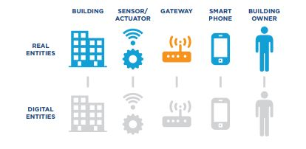
Next we need to connect the real entity to its digital entity counterpart using a mixture of devices.
SENSORS
ACTUATORS
GATEWAYS
Real Entities and their digital entity counterparts.

Slide 7
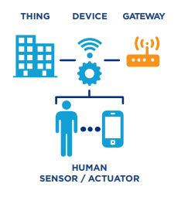
1.3 HUMAN vs MACHINE
“Halfway houses” where IoT “applications is waiting” use humans to play roles that will eventually be played by machines/sensors.
Human with a smartphone is extremely capable in the role of sensor/actuator, adding two more useful entities to the IoT and giving us a way to realize the IoT right now.
Even more importantly, the combination of “HUMAN + SMARTPHONE” is a practical solution to two of the thorniest problems with autonomous devices: how to provide reliable power and connectivity.
Human as sensor/actuator.

Slide 8
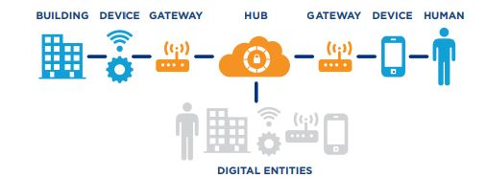
1.4 CONNECT, COMMUNICATE & SHARE
Digital entities are concrete software objects hosted by a software service, which we refer to as Hub.
The Hub provides storage, processing and connectivityfor digital entities, running locally and remotely - in the cloud.
This enables digital entities to define and execute behavioral rukes for e.g. performance, quality, compliance and security, and to store data for e.g. attributes, relationships, events and logs.
Hub as digital entity hosting service.

Slide 9
2. FUTURE VALUE OF IOT
Gartner estimates that the resulting global economic value add to industry as a result of increasing sales and decreasing inputs and costs will be $1.9 trillion, split across a variety of industry sectors.
By 2020 the IoT will include an estimated 26 billion installed units. Others estimate that anywhere from 30 billion to 50 billion devices will be connected by then.
This includes key service elements such as configuration & customization of IoT solutions, integration and data analytics.

Slide 10
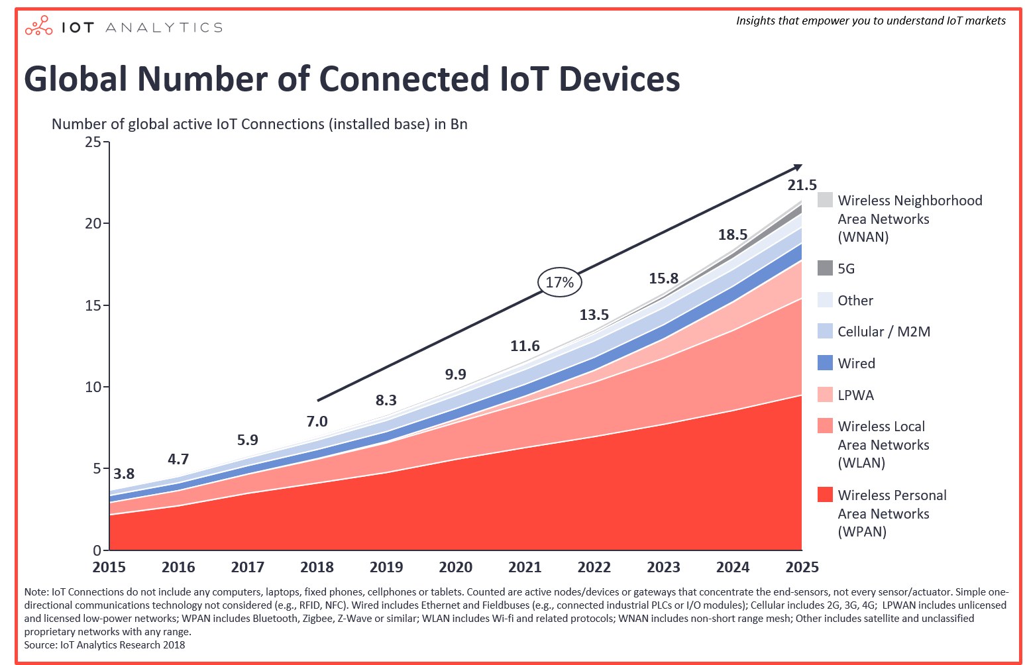
Projected growth of connected entities

Slide 11
3. APPLICATIONS OF IOT
Transport & Logistics
Smart Grid
Smart Cities
Wearables
Agriculture

Slide 12
TCP/IP STACK
LAYERS | PROTOCOLS
Application | HTTP, FTP, mDNS, WebSocket, OSC ..
Transport | TCP, UDP
Internet | IP
Link | Ethernet, Wi-Fi...

Slide 13
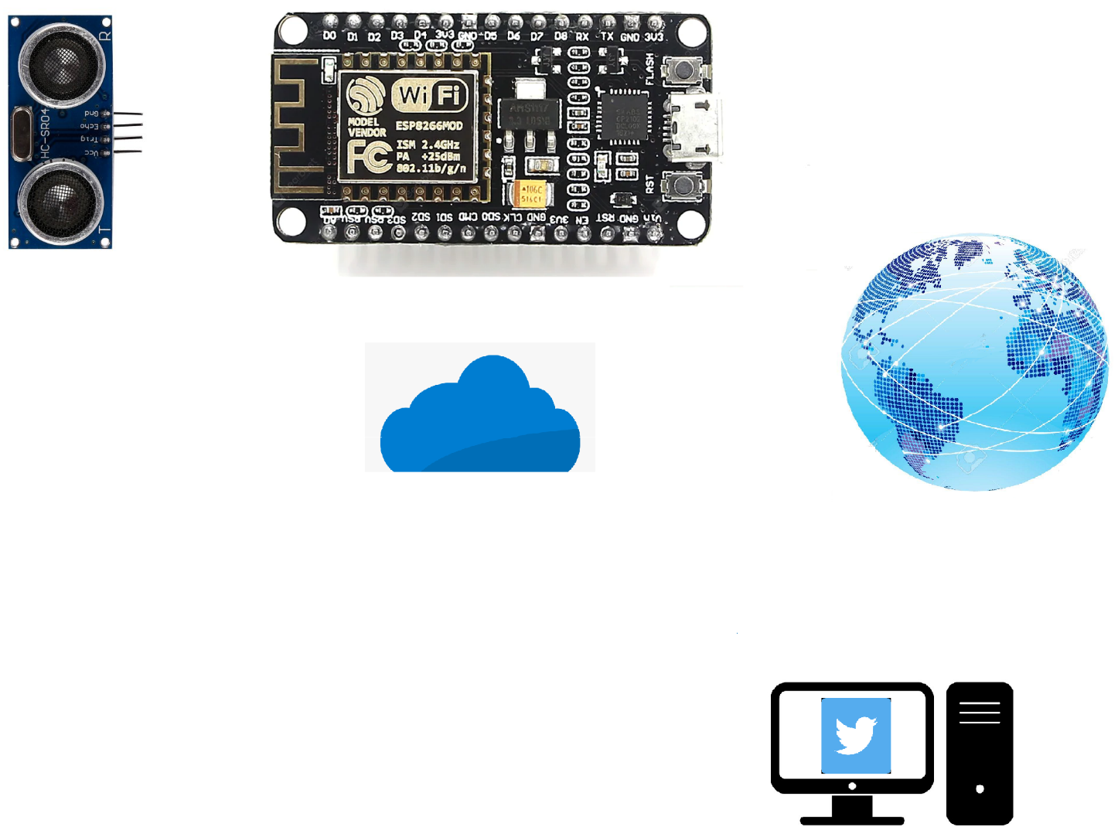

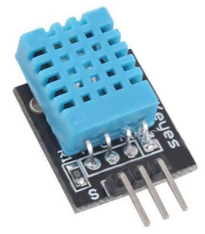
3.1 WASTE MANAGEMENT & WEATHER MONITORING
Ultrasonic Sensor
ESP 8266
Internet
Cloud Server
DHT 11 Sensor

Slide 14
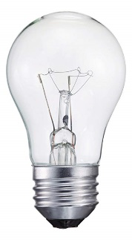
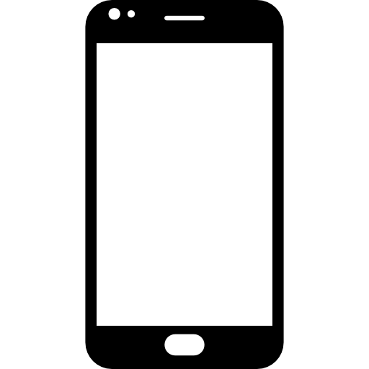
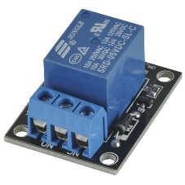
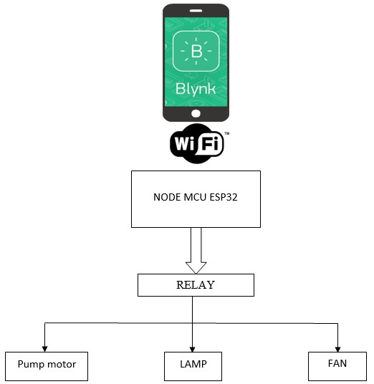

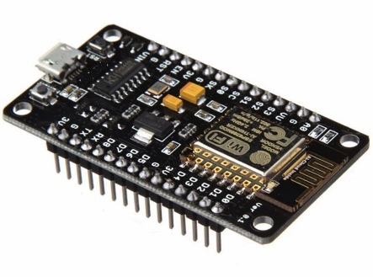
3.2 HOME AUTOMATION
Relay
Esp8266
Blynk Server
Github: https://github.com/MohdFaisal2165/IOT-Applications?files=1

Slide 15
4 RESEARCH CHALLENGES IN IOT
Energy-efficiency of sensors crucial for IIoT Development
Cost of Sensor devices
Power consumption of the radio signals used
IoT devices are exposed various security threats
Meeting the PCB design challenge

Slide 16
4.1 Design for energy-efficient IIoT sensor nodes
Energy-efficient sensor nodes are crucial to the development of the industrial internet of things (IIoT).
This demands a complex approach to energy efficiency.
The problem that faces the engineering team trying to optimise the energy consumption of an IIoT sensor node is that many of the design decisions interact with each other.

Slide 17
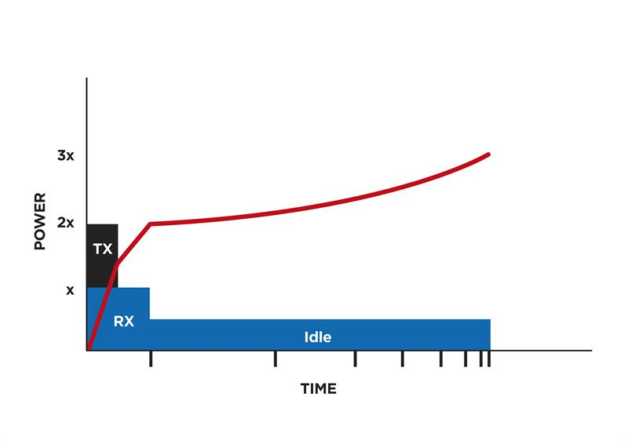
Despite the complex interaction between application design and implementation, there are some high-level choices that are likely to lead toward an optimal solution. One of these is the use of integration.
The other fundamental consideration for designing energy-efficient IIoT sensor nodes is an understanding of the duty cycle and its impact on lifetime energy consumption.
Relationship between time and power consumed

Slide 18
4.2 Low cost sensors will help the IoT to be realised
One of the largest opportunities for IoT applications is environmental sensing.
At the simplest, these could be measuring temperature, but more complex devices are being considered which can assess environmental quality.
Georgia Tech team in the US believes it might have made significant progress in that direction by working on GaN based sensors.

Slide 19
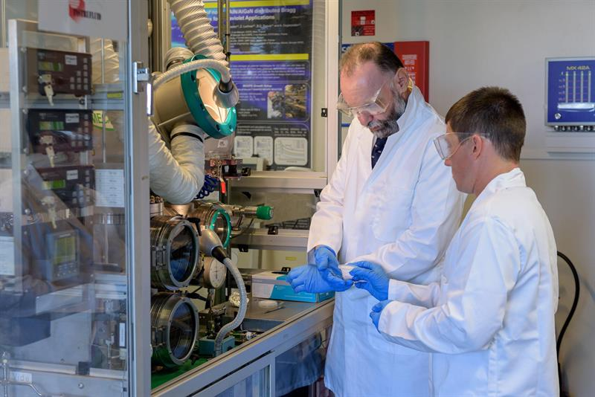
Economical and flexible with improved performances.
Range of applications, specially in wearable sensing devices.
Prof Abdullah Ougazzaden, left, and researcher Chris Bishop examine a sample sensor.

Slide 20

4.3 Power consumption of the Radio Signals used
For battery powered devices, power consumption of the radio signal is significant.
Must select appropriate radio signal.(BLE, Wi-fi, Cellular, etc.)
For Wi-fi signals, a power saving mode can be implemented.
For Cellular signals the communication protocol used must be efficient.
Bluetooth low energy technology is promising for low power consumption

Slide 21
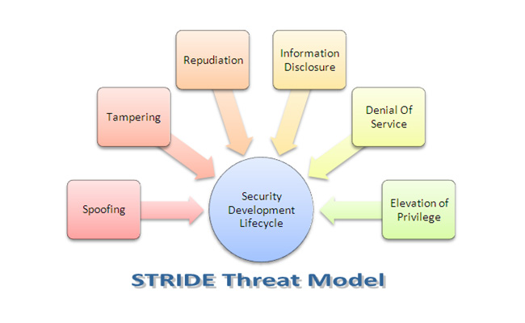
4.4 Building security into IoT devices: the new potential for security integration
The STRIDE threat classification model, originally developed by Microsoft, lists the potential security threats an IoT device or user of that device faces: Spoofing; Tampering; Repudiation; Information disclosure; Denial of service; and Elevation of privilege.

Slide 22
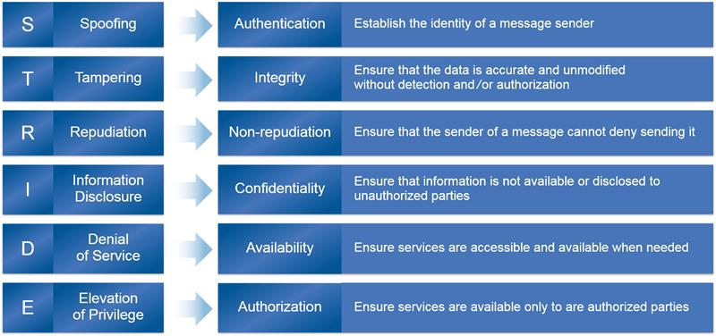
Each STRIDE threat requires a protecting counter-measure

Slide 23
4.5 Meeting the PCB design challenge
Although the IoT is still in its early days, applications developers are already looking to put more electronics into smaller packages.
Not only that, many products are being designed to fit into odd shapes or to fit into whatever space may be available in existing devices.
Multiple Boards: Distributing the electronics among several PCBs is one solution to most of the challenges associated with IoT devices.
In other applications, the electronics must fit into an existing package that may not have been designed to house additional components, so integrating them, as well as finding power, can be a challenge.

Slide 24
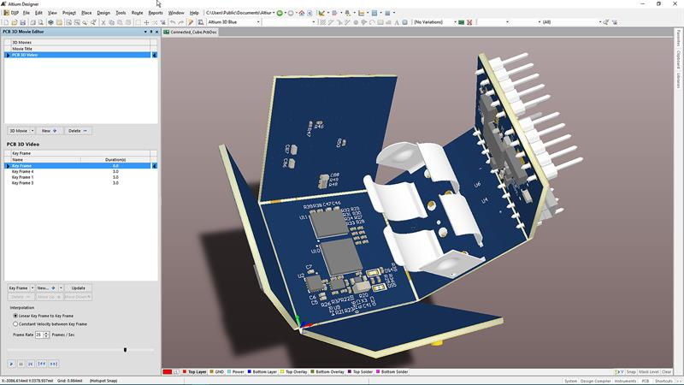
Typical multiple board design

Slide 25
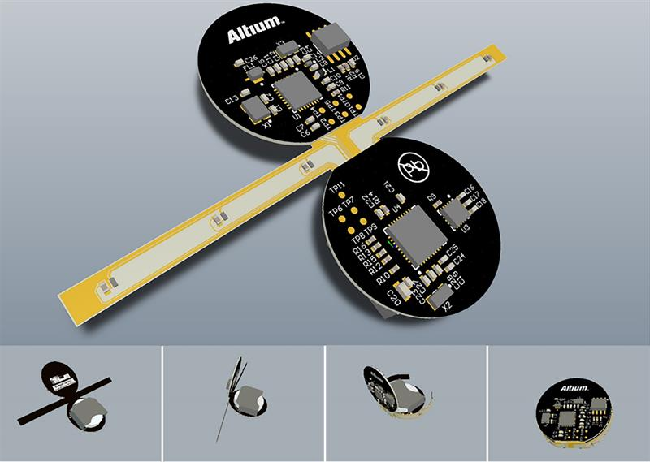
Full motion 3D visualisation allows designers to better communicate to manufacturing how products are assembled

Slide 26
5. CONCLUSION
Smart Cities - cities will be able to automate, remotely manage, and collect data through visitor kiosk, video camera surveillance, automobile rentals.
Everyone will adapt these techniques to become smart in technologies and save time and energy.
The main benefits of autonomous capabilities in the future IoT is to extend and complement human performance.
Robotic manufacturing and medical nanobots may be useful; however, devices (including robots) run software created by human.
Cooperation and collaboration between vendors is essential for a secure future IoT, and there is no guarantee of success.

Slide 27


Slide 28


